Slide 1
Software Requirements Analysis, Design and Modeling
Chapter 5.1
Elaboration Iteration 2 and Case Studies
Notes:
这节课，我们一起学习
第 5.1 章节 第18个知识域：细化迭代 2 与案例研究
//下面是备注 不放入脚本
对应课本23-34 章 P292-298
注意中文和英文的23与24章是颠倒的

Slide 2
Objectives
Define the requirements for iteration-2.
Quickly highlight some analysis artifact changes especially in the domain models of the cases.
Notes:
本次课的目标是
1.为迭代 2 定义需求
2.快速地突出显示一些分析制品的变更
特别是案例领域模型中的变更

Slide 3
Content Outline
Iteration 2: Quick Analysis Update.
Iteration 2: More Patterns.
Notes:
首先介绍
迭代2：快速分析更新

Slide 4
Quick Analysis Update :Introduction
This chapter briefly points out some changes in the requirements and domain analysis.
The noteworthy modeling and UML tips of interest are related to the NextGen SSDs and domain model.
Notes:
快速地更新分析 简介
1.本章简要介绍需求和领域分析中的一些变更
2.同时介绍与NextGen的SSD和领域模型
相关的值得注意的建模和UML技巧

Slide 5
Case Study: NextGen POS
Use Cases
At a process level I recommend (as does the UP) a second short one- or two-day requirements workshop this iteration (near the end of iteration-1 and again near the end of iteration-2), within which more requirements will be investigated and written in detail.
The previously fully analyzed use cases (for example, Process Sale) will be revisited and probably refined based on insights gained from iteration-1 programming and tests.
In iterative methods, note the interplay of early programming and testing with parallel requirements analysis that is improved by feedback from early development.
Notes:
用例
1.在过程的级别上，（如同UP）我建议
在本次迭代举行为期一到两日的简短的需求讨论会
（在迭代1接近结束时是如此，在迭代2结束时也是如此）
在这期间将会调查和详细编写更多需求
2.对于先前已经充分分析的用例（例如处理销售）
将会基于在迭代1编程和测试中所获得的理解重新进行讨论
并且有可能进行精化
3.在迭代方法中，要注意早期编程和测试
与同时进行的需求分析之间的相互影响
需求分析将基于对早期开发的反馈进行改进

Slide 6
SSDs-1
This iteration includes adding support for third-party external systems with varying interfaces, such as a tax calculator. The NextGen POS system will be remotely communicating with external systems.
Consequently, the SSDs should be updated to reflect at least some of the inter-system collaborations, in order to clarify what the new system-level events are.
Notes:
这次迭代包括
1.增加对具有不同接口的第三方外部系统（例如，税金计算器）的支持
NextGen POS系统将与这些外部系统进行远程通信
因此，为了阐明有哪些新的系统级事件
我们应该更新SSD
使其至少能够反映一些系统间的协作
//
Figure 23.1 illustrates an SSD for one scenario of paying by credit, which requires collaboration with several external systems. Even though the design of paying by credit is not handled in this iteration, the modeler (me) has drawn an SSD based on it (and probably several others as well), to better understand the inter-system collaboration, and thus the required support for varying interfaces in the external systems.

Slide 7
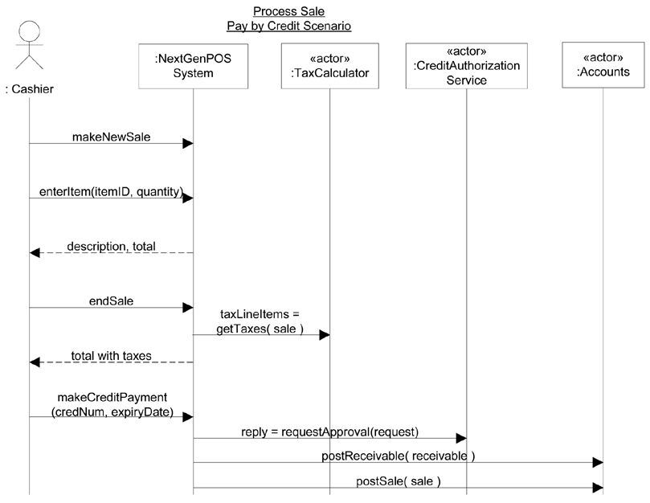
SSDs-2
Figure 23.1. An SSD scenario that illustrates some external systems.
leolin@baja.com.cn
Notes:
图23.1阐述了信用卡支付场景的SSD
其中需要与若干外部系统进行相互协作

Slide 8
Domain Model
In this iteration, it is quite reasonable to skip refining the Domain Model, move quickly on to design work, and let the discovery of new domain concepts occur during object design in the Design Model, when the developers are thinking through a solution, or indeed even while coding.
A sign of process maturity with the UP is understanding when creating an artifact will add significant value, or is a kind of mechanical "make work" step and better skipped.
Notes:
1.在此次迭代中，比较合理的做法是
跳过对领域模型的精化
快速投入到设计工作中
在对设计模型进行对象设计的过程中
在开发人员考虑好解决方案时
甚至在实际编码时 去挖掘新的领域概念
2.使用UP的过程成熟标志是
知道何时创建制品能够带来显著价值
或者当遇到呆板的完成作业式的步骤时能够较好地略过

Slide 9
Content Outline
Quick Analysis Update.
Iteration 2: More Patterns.
Notes:
最后介绍
迭代2： 更多设计模式

Slide 10
More Patterns : Introduction
The inception phase chapters and those for iteration-1 in the elaboration phase emphasized a wide range of fundamental analysis and object design skills, in order to share information on a breadth of common steps in building object systems.
In this iteration, the case study just emphasizes:
essential object design
the use of patterns to create a solid design
applying the UML to visualize the models
These are primary objectives of the book, and critical skills.
Notes:
1.初始阶段的几章和讲述细化阶段中迭代1的几章中
强调了广泛使用的基本分析和
对象设计技术
2.在本次迭代中 案例研究只强调
2.1基本对象设计
2.2使用模式来创建稳固的设计
2.3应用UML来使模型可视化
3.这些内容是本书的主要目标和关键技术

Slide 11
From Iteration 1 to 2
All the software has been vigorously tested: unit, acceptance, load, usability, and so on.
Customers have been regularly engaged in evaluating the partial system, to obtain feedback for adaptation and clarification of requirements.
The system, across all subsystems, has been completely integrated and stabilized as a baselined internal release.
Notes:
从迭代1到迭代2
1.在迭代1结束的时候 应该已经完成了下列任务
所有软件都已经被充分地测试：单元、验收、负载、可用性等（测试）
2.客户定期地参与对已完成部分的评估
从而使开发人员获得对调整和澄清需求的反馈
3.已经对系统，包括所有的子系统，进行了完整的集成和固化
使其成为基线化的内部版本

Slide 12
Iteration-2 Requirements and Emphasis: Object Design and Patterns
Iteration-2 largely ignores requirements analysis and domain analysis, and focuses on object design with responsibilities and GRASP, and applying some GoF design patterns.
Some license is taken with the prioritization of requirements, preferring those that support the educational goals, rather than project risk goals.
The educational goals are to help explain fundamental ideas and principles of OOA/D in the early iterations
Notes:
迭代2的需求和重点：对象设计和模式
1.迭代2很大程度上忽视了案例研究的需求分析和领域分析
而是着重于使用职责和GRASP进行对象设计
并且应用一些GoF设计模式
2.我们在定义需求的优先级时采取了一些特例
其目的是为了支持教学目标而非项目风险目标
3.这个教学目标是帮助我们在早期迭代中
解释OOA /D的基本思想和原则

Slide 13
Iteration-2 of the NextGen POS application
Iteration-2 of the NextGen POS application handles several interesting requirements:
Support for variations in third-party external services.
Complex pricing rules.
A design to refresh a GUI window when the sale total changes.
These requirements will only be considered (for this iteration) in the context of scenarios of the Process Sale use case.
Notes:
NextGen POS应用中的迭代2
1.要处理以下几个我们关注的需求
1.1支持第三方外部服务的变化
1.2 复杂的定价规则
1.3 需要进行设计，使得在销售总额变化时刷新GUI窗口
2.只在处理销售用例的场景语境中
才(为本次迭代)考虑这些需求

Slide 14
Main Success Scenario
Main Success Scenario:
Customer arrives at a POS checkout with goods and/or services to purchase.
Cashier tells System to create a new sale.
Cashier enters item identifier.
System records sale line item and presents item description, price, and running total.
Price calculated from a set of price rules.
Notes:
主成功场景
1.顾客携带所要购买的商品或服务到达POS收费口
2.收银员请求系统创建新销售
3.收银员输入商品项目的标识
4.系统记录销售项目并展现该项目的描述、价格和累计总额
根据一系列定价规则计算价格

Slide 15
Supplementary Specification
Interfaces
Software Interfaces
For most external collaborating systems (tax calculator, accounting, inventory, ... )
we need to be able to plug in varying systems and thus varying interfaces.
Notes:
补充规约
接口
1.软件接口
2.对于重要的外部协作系统（税金计算器，账务，库存）
3.我们需要插入各种系统 因此需要多种接口

Slide 16
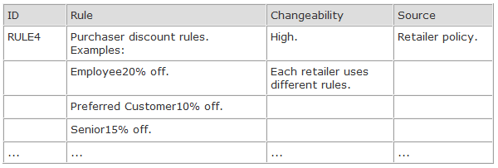
Domain (Business) Rules
Domain (Business) Rules
Notes:
领域规则
规则编号：规则4
规则描述：购买者打折规则
例如: 员工打折20% 优先顾客打折10% 高级顾客打折15%
可变性：可变性高政策 每个零售商都有不同的规则
来源： 零售商

Slide 17
Incremental Development for a Use Case Across Iterations
Because of these requirements, we are revisiting the Process Sale use case in iteration-2, but implementing more scenarios, so that the system incrementally grows.
It is common to work on varying scenarios or features of the same use case over several iterations and gradually extend the system to ultimately handle all the functionality required.
On the other hand, short, simple use cases may be completely implemented within one iteration.
However, one scenario should not be split across iterations; an iteration should complete one or more end-to-end scenarios.
Notes:
跨越多次迭代对用例进行增量式开发
1.由于这些需求
我们要在迭代2中对处理销售用例进行修订
但是因为实现了更多场景，所以该系统是增量式发展的
2.常见的方式是，在多次迭代中对同一用例的不同场景或特性进行工作
并且逐渐地扩展系统以最终实现对所有功能需求的处理
3.另一方面，在一次迭代内也可以完全实现一些简短的用例
4.但是，不应该把一个场景分开在多次迭代中处理
一次迭代应该完成一个或多个端到端的场景

Slide 18
Review : Elaboration Iteration 2 and Case Studies
How to update analysis quickly?
When iteration-1 ends, what should be accomplished?
In the iteration-2,what does the case study emphasizes?
Notes:
下面请大家 回顾一下本次课的知识内容
1. 如何快速更新分析?
2. 当迭代1 结束时，应该完成哪些任务?
3. 在迭代2，案例研究强调的内容是什么？

Slide 19
Special Topics
What is the essential object design?
How to use patterns to create a solid design?
How to apply the UML to visualize the models?
Notes:
最后，作为扩展知识域的学习
请大家课后回答
1.什么是对象设计的本质？
2.如何使用模式创建坚实的设计？
3.如何使用UML可视化建模？

